Slide 1
Test Automation & Advanced Selenium
Lesson 3: Working With Selenium IDE

Slide 2
Lesson Objectives
Selenium IDE – An Introduction
Installation of Selenium IDE
Components of Selenium IDE
Introduction to Selenium Commands – “Selenese”
Understanding Element Locators in Selenium IDE
ID
Name
Link Text
CSS Selector
Tag and ID
Tag and class
Tag and attribute
Tag, class, and attribute
Inner text
DOM (Document Object Model)
getElementById
getElementsByName
dom:name
dom:index
Working with Alerts
Creating Test Script using Selenium IDE
Creating & Executing Test Suits
Exporting scripts to multiple languages and Formats

Slide 3
3.1: Working With Selenium IDE Selenium IDE – An Introduction
Selenium provides a record/playback tool for authoring tests without learning a test scripting language (Selenium IDE).
Selenium IDE, fully-featured Integrated Development Environment (IDE)
Installs as a plugin in Mozilla Firefox
Enables developers to test their web applications through Selenium
Records user interactions with the web browser and play back to test for errors
Effortless to install and easy to learn

Slide 4
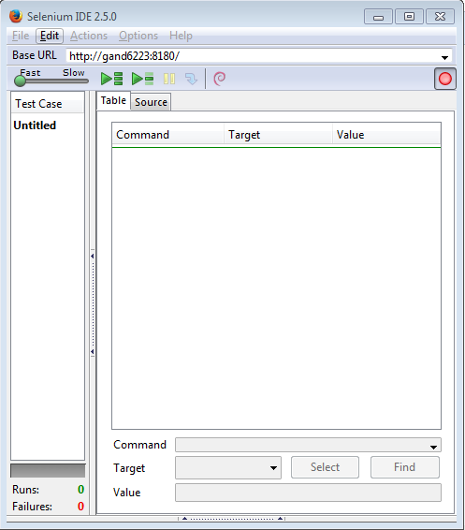
3.1: Working With Selenium IDE Installation of Selenium IDE
Download Selenium IDE
Copy Selenium IDE file to extensions folder of Mozilla Firefox.
To facilitate opening of .xpi file for selenium you can drag and drop the .xpi file on the Mozilla browser to install it and get it in the add-ons of the browser

Slide 5
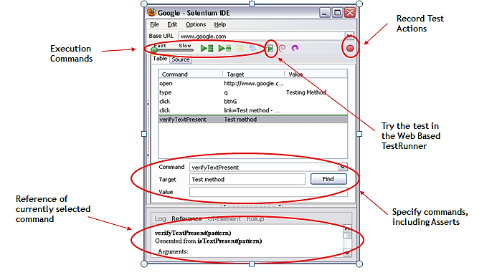
3.1: Working With Selenium IDE Components of Selenium IDE

Slide 6
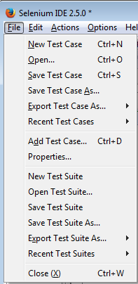
3.1: Working With Selenium IDE Components of Selenium IDE (Cont.)
Menu Bar
Positioned at the upper most of the Selenium IDE window
File Menu
Allows user to:
Create new test case, open existing test case, save the current test case
Export Test Case As option exports and converts only the currently opened Selenium IDE test case
Export Test Case As and Export Test Suite As in any of the associated programming language compatible with Selenium RC and WebDriver
Export Test Suite As option exports and converts all the test cases associated with the currently opened IDE test suite
Close the test case
Notes:
1.File Menu
It is very much analogous to the file menu belonging to any other application.
Export Test Case As and Export Test Suite give the liberty to the user to prefer amid the available unit testing frameworks like jUnit, TestNG etc.
Thus an IDE test case can be exported for a chosen union of programming language, unit testing framework and tool from the selenium package.

Slide 7
3.1: Working With Selenium IDE Components of Selenium IDE (Cont.)
Tool Bar
Contains buttons for controlling the execution of your test cases
Step feature for debugging your test cases
Speed Control: Controls how fast your test case runs
Run All: Runs the entire test suite when a test suite with multiple test cases is loaded
Run: Runs the currently selected test. When only a single test is loaded this button and the Run All button have the same effect
Pause/Resume: Allows stopping and re-starting of a running test case
Notes:
The Selenium IDE test cases can be saved into following format:
HTML format
The Selenium IDE test cases can be exported into following formats/programming languages.
java (IDE exported in Java)
rb (IDE exported in Ruby)
py (IDE exported in Python)
cs (IDE exported in C#)

Slide 8
3.1: Working With Selenium IDE Components of Selenium IDE (Cont.)
Tool Bar
Step: Allows you to “step” through a test case by running it one command at a time. Use for debugging test cases
Apply Rollup Rules: This advanced feature allows repetitive sequences of Selenium commands to be grouped into a single action. Detailed documentation on rollup rules can be found in the UI-Element Documentation on the Help menu
Record: Records the user’s browser actions.
Notes:
The Selenium IDE test cases can be saved into following format:
HTML format
The Selenium IDE test cases can be exported into following formats/programming languages.
java (IDE exported in Java)
rb (IDE exported in Ruby)
py (IDE exported in Python)
cs (IDE exported in C#)

Slide 9
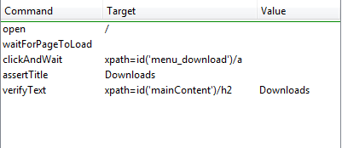
3.1: Working With Selenium IDE Components of Selenium IDE (Cont.)
Test Case Pane
Script is displayed in the test case pane
It has two tabs:
Displays the command and their parameters in a readable “Table” format
“Source” displays the test case in the native format in which the file will be stored
By default, this is HTML although it can be changed to a programming language such as Java or C#, or a scripting language like Python

Slide 10

3.1: Working With Selenium IDE Components of Selenium IDE (Cont.)
Command, Target and Value
Command displays the currently selected command along with its parameters
Target displays unique tag value for the selected field
Value contains the data in case of text box fields

Slide 11

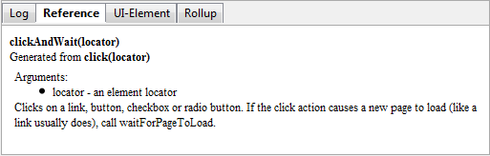
3.1: Working With Selenium IDE Components of Selenium IDE (Cont.)
Log/Reference/UI-Element/Rollup Pane
Bottom pane is used
Log: Error messages and information messages showing the progress are displayed automatically
Reference : Displays documentation on the current command in table mode
UI-Element and Rollup: Detailed information on these two panes (which cover advanced features) can be found in the UI-Element Documentation on the Help menu of Selenium-IDE
Notes:
Log/Reference/UI-Element/Rollup Pane
The bottom pane is used for four different functions–Log, Reference, UI-Element, and Rollup–depending on which tab is selected.
Log
When you run your test case, error messages and information messages showing the progress are displayed in this pane automatically, even if you do not first select the Log tab. These messages are often useful for test case debugging. Notice the Clear button for clearing the Log. Also notice the Info button is a drop-down allowing selection of different levels of information to log.
Reference
The Reference tab is the default selection whenever you are entering or modifying Selenese commands and parameters in Table mode. In Table mode, the Reference pane will display documentation on the current command. When entering or modifying commands, whether from Table or Source mode, it is critically important to ensure that the parameters specified in the Target and Value fields match those specified in the parameter list in the Reference pane. The number of parameters provided must match the number specified, the order of parameters provided must match the order specified, and the type of parameters provided must match the type specified. If there is a mismatch in any of these three areas, the command will not run correctly.
While the Reference tab is invaluable as a quick reference, it is still often necessary to consult the Selenium Reference document.

Slide 12
3.1: Working With Selenium IDE Introduction to Selenium Commands – “Selenese”
Set of commands used by selenium to automate the web application testing
Combination of Selenese commands creates test script
3A’s Selenese is a combination of as 3A’s:
Action: Used to change the state of the AUT(Application under Test)
E.g.: Click , close , doubleclick
Accessor: Check the state of application & save state in some variable
E.g.: storeTitle , storeElementPresent
Assertions: Verifies the state of the application matches it with the expected state and generates the True/False result
E.g. : verifyText, assertText
Notes:
Action:
Used to change the state of the AUT(Application under Test)like click on some link, type a value in edit box, select some options on the page, select a value from drop down etc.
When action is performed on AUT the test will fail if the action is not achieved.
Accessor:
This command check the state of the application and save the application state in some variable. It can be used for automatic generation of assertions.
Assertions:
Are very similar to checkpoint in UFT/QTP. Assertion verifies the state of the application matches it with the expected state and generates the True/False result.

Slide 13
3.1: Working With Selenium IDE Understanding Element Locators in Selenium IDE
Types of Element Locators
ID
Name
Link Text
CSS Selector
Tag and ID
Tag and class
Tag and attribute
Tag, class, and attribute
Inner text
DOM (Document Object Model)
getElementById
getElementsByName
dom:name
dom: index
XPath

Slide 14
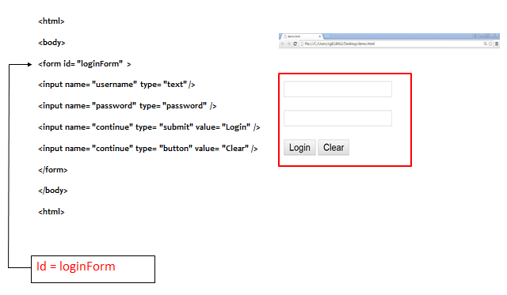
3.1: Working With Selenium IDE Locating by ID

Slide 15
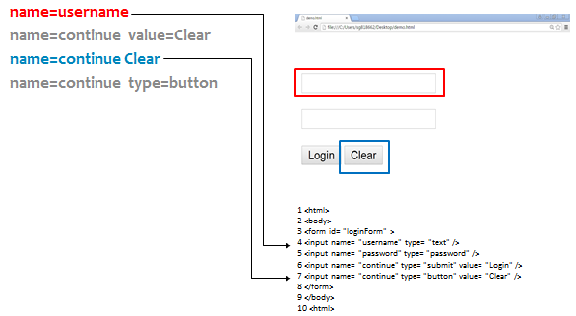
3.1: Working With Selenium IDE Locating by NAME

Slide 16
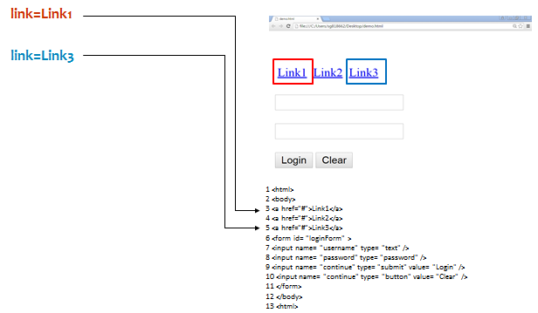
3.1: Working With Selenium IDE Locating by Link Text

Slide 17
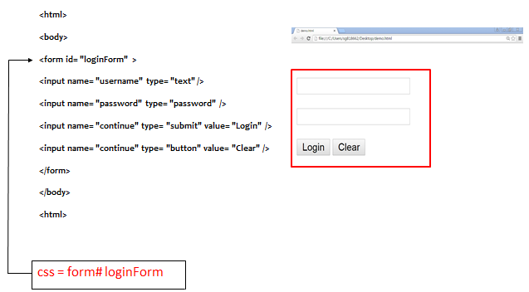
3.1: Working With Selenium IDE Locating by CSS Selector - Tag and ID

Slide 18
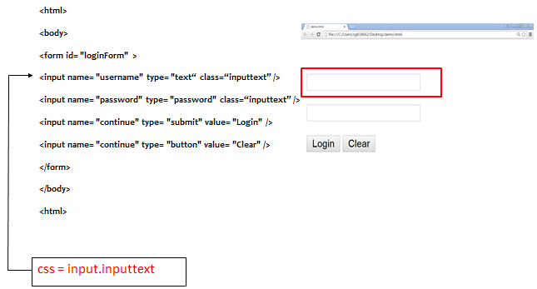
3.1: Working With Selenium IDE Locating by CSS Selector - Tag and Class

Slide 19
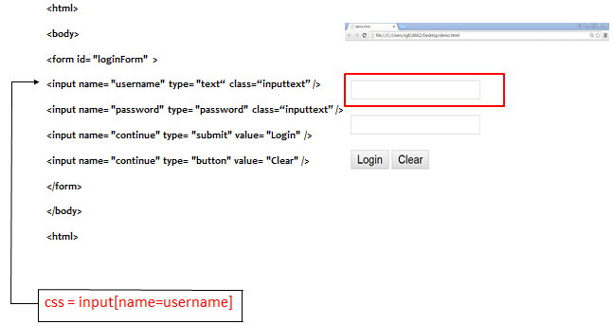
3.1: Working With Selenium IDE Locating by CSS Selector - Tag and Attribute

Slide 20
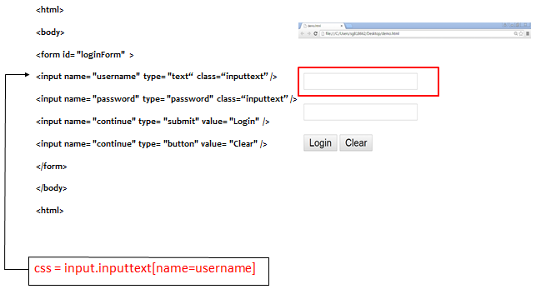
3.1: Working With Selenium IDE Locating by CSS Selector – Tag, Class and Attribute

Slide 21
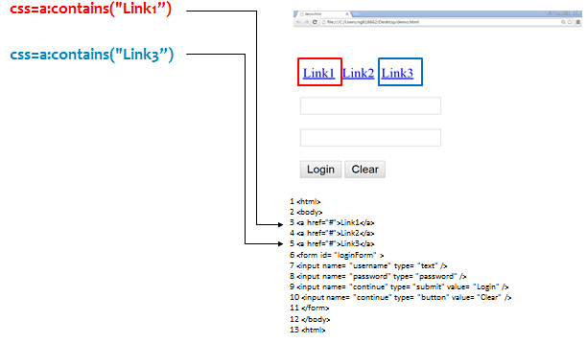
3.1: Working With Selenium IDE Locating by CSS Selector – Inner text

Slide 22
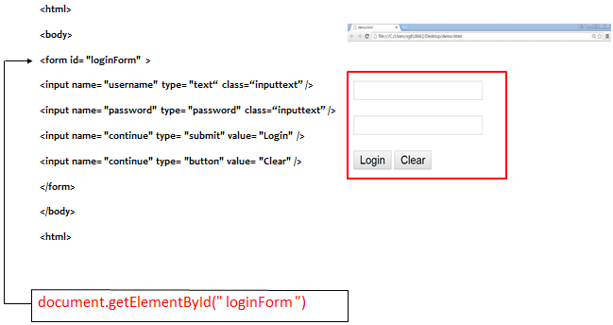
3.1: Working With Selenium IDE Locating by DOM – getElementsById

Slide 23
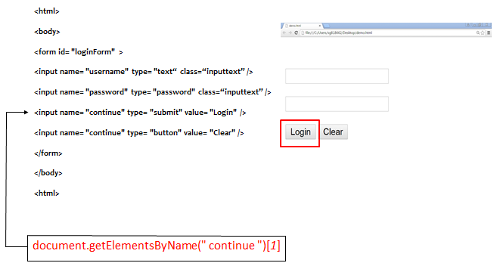
3.1: Working With Selenium IDE Locating by DOM – getElementsByName

Slide 24
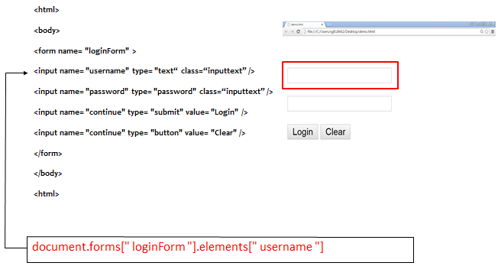
3.1: Working With Selenium IDE Locating by DOM – DOM:Name

Slide 25
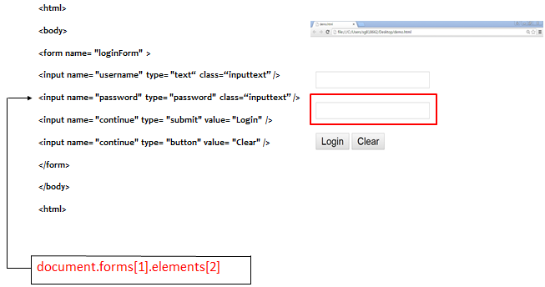
3.1: Working With Selenium IDE Locating by DOM – DOM:Index

Slide 26
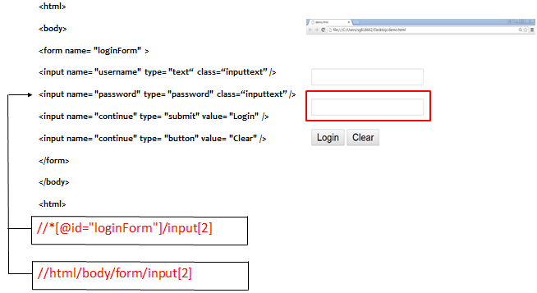
3.1: Working With Selenium IDE Locating by XPath

Slide 27
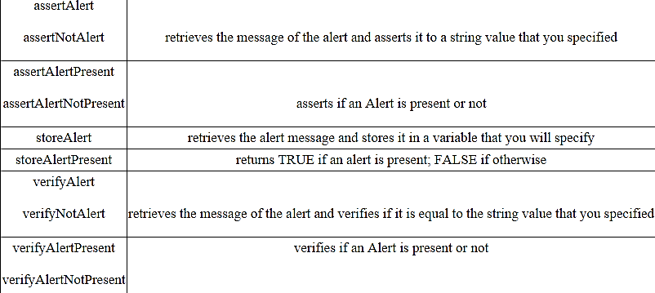
3.1: Working With Selenium IDE Working With Alerts
Simplest form of pop-up windows
Most common Selenium IDE commands used in handling alerts are the following :

Slide 28
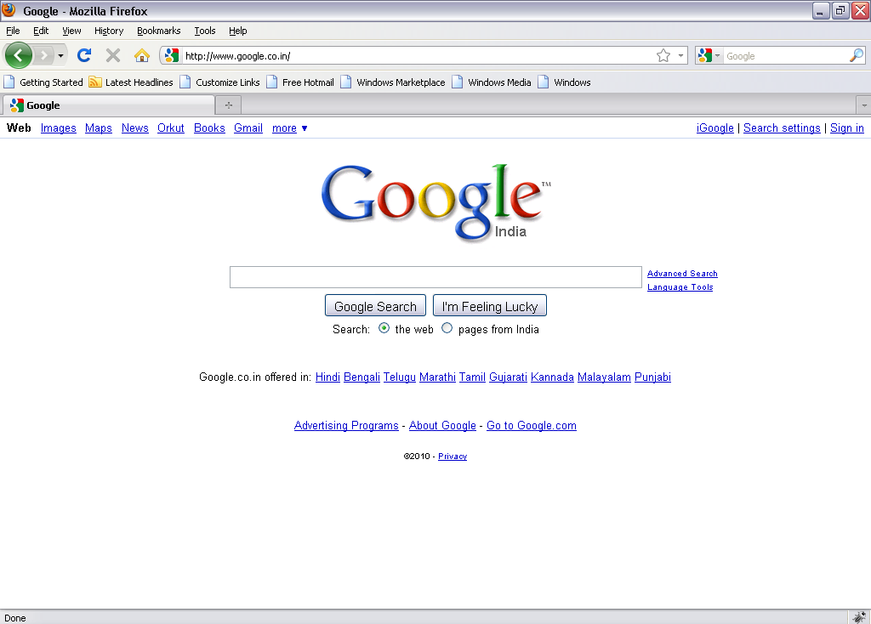
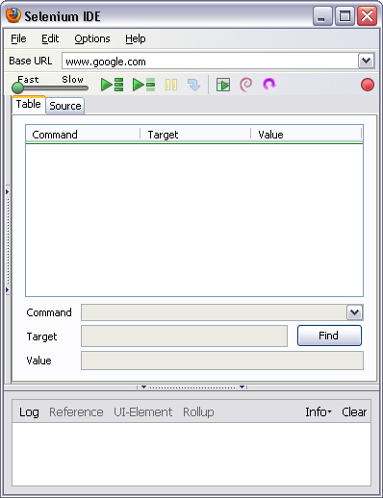
3.1: Working With Selenium IDE Creating Test Scripts using Selenium IDE
Go to the Web Page for which you want to carry out the test
Hit the record button on IDE

Slide 29
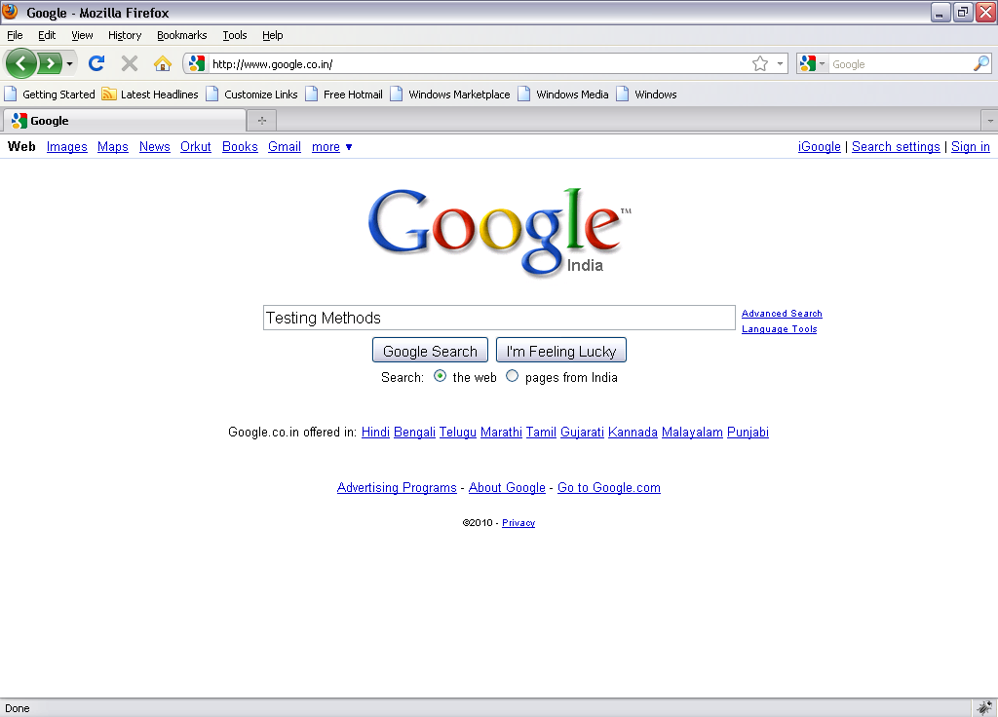
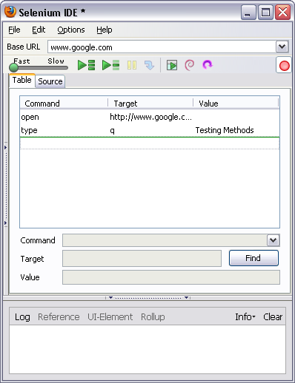
3.1: Working With Selenium IDE Creating Test Scripts using Selenium IDE(Cont.)
Enter the text on Web Page and submit
IDE should be updated, stop the recorder and add the assertions

Slide 30
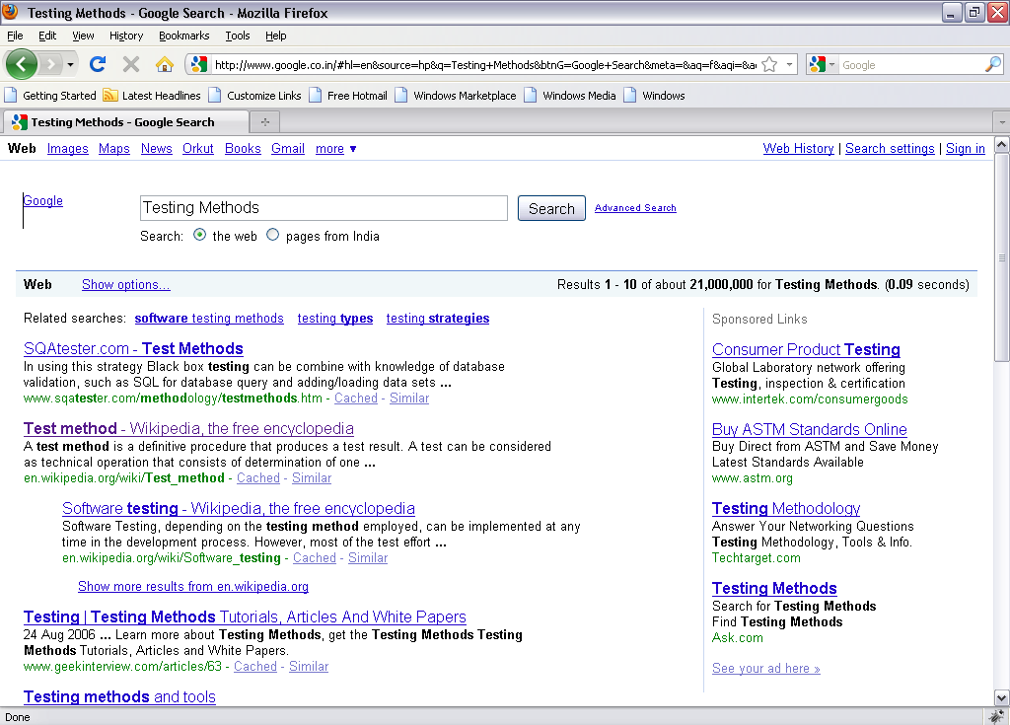
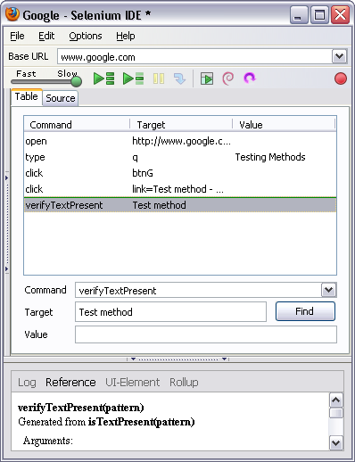
3.1: Working With Selenium IDE Creating Test Scripts using Selenium IDE(Cont.)
Play Button
Hit the play button to play the recorded scripts

Slide 31
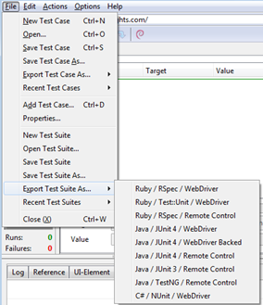
3.1: Working With Selenium IDE Exporting scripts to multiple languages and Formats
Test cases can be exported only to the following formats:
.cs (C# source code)
.java (Java source code)
.py (Python source code)
.rb (Ruby source code)

Slide 32
Summary
In this lesson, you have learnt
Selenium IDE (Integrated Development Environment) is the simplest tool in the Selenium Suite.
Menu bar is used in creating, modifying, and exporting test cases into formats useable by Selenium RC and WebDriver
The default format for Selenese commands is HTML.
The Test Case Pane shows the list of currently opened test cases and a concise summary of test runs
Locators tell Selenium IDE which GUI elements ( say Text Box, Buttons, Check Boxes etc.) its needs to operate on
The choice of locator depends largely on your Application Under Test
Notes:
Add the notes here.

Slide 33
Review Question
Question 1
Select the Locator which is NOT part of Selenium IDE
CSS Selector
XPath
getElementsById
getElementsByXpath
Question 2: True/False
The choice of locator depends largely on your Application Under Test.
Question 3: Fill in the Blanks
Error messages and information messages showing the progress are displayed automatically in ______ pane.

